Slide 1
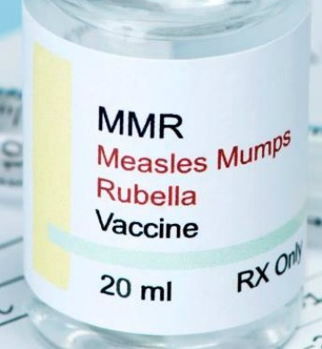
Team Git Shots
Team Members:
Cristy Brust
Hemani Choksi
Olan Johnson
Stefani Kenyon
Ning Xie

Slide 2
Motivation and Summary
Core Objectives:
Investigate the global trend of measles outbreaks over the last five years
Examine the relationship between vaccination rates and measles outbreaks in the U.S.
Research driven by Global and U.S. centric questions
Summary of Key Findings:
In the Americas, YTD measles cases have surpassed 2018 totals
Despite the fact that the majority of imported measles cases in the US are reportedly associated with travel to/from Israel, Israel was not among the top 5 countries in the EMR.
In the US, generally New York state as a whole has more indigenous cases while NYC’s cases are mostly imported
Notes:
Given the recent outbreak of measles, our team decided to examine trends associated with measles outbreaks and vaccination rates in the U.S.
Because the current outbreak of measles are believed to be imported as a result of international travelers, we wanted to look at the recent global trend of measles outbreaks as well.
Summary of Findings: (include how well we were able to answer questions)
Finding 1
Finding 2
Finding 3

Slide 3
Questions & Data
Global-centric Questions:
Over the last five years, were cases of measles outbreaks on the rise globally?
During the period in question, what was the distribution of measles outbreaks between the developed and developing world?
U.S.-centric Questions:
Has there been an increase or decrease in MMR vaccinations in the U.S. over the last 10 years?
How did the 2015 outbreak of measles in the U.S. influence MMR vaccination rates? As a result, what response could we expect to see during the current outbreak?
What is the current distribution of indigenous and imported measles cases in the U.S.?
What is the relationship between state vaccination exemptions and measles cases reported by state?
Immunization rate vs. outbreak in 2014/2015 (period of last measles outbreak in the US) could use this visualization to further explain trend analysis in #3. - Hemani
Outbreak Data Sources:
World Health Organization (WHO) surveillance data
Centers for Disease Control and Prevention (CDC) National Notifiable Diseases Surveillance System (NNDSS) data
Vaccination Data Sources:
CDC ChildVaxView vaccination coverage records
National Conference of State Legislatures (NCSL) vaccination exemption records

Slide 4
Data Cleanup & Exploration
Unexpected Insights
Excessive data is not necessarily a good thing
Core data subject to unregulated reporting practices
Discrepancies between datasets
Roadblocks and Resolutions:
Main Problem: Data integrity
Resolution: Re-work research questions
Cleanup Process:
Standardizing data
New DataFrame creation
Notes:
Our cleanup process was primarily focused on ensuring that pertinent data was standardized across the board, in particular country names and non UTF-8 characters.
Data limitations: WHO and CDC outbreak data is subject to unregulated reporting practices. As a result, the number of cases reported might only reflect a small portion of the true number of cases.
Ning: located target row; create a whole new DF
Stefanie
The World Bank data set had countries listed that were not in WHO data set and vice versa
In the WHO data set, some cells were blank so I replaced the blanks with zeros (so either there were cases that may not have been reported or they really did not have any cases)

Slide 5
Data Analysis & Discussion
Notes:
Discuss the steps you took to analyze the data and answer each question you asked in your proposal
Present and discuss interesting figures developed during analysis, ideally with the help of Jupyter Notebook
Discuss your findings. Did you find what you expected to find? If not, why not? What inferences or general conclusions can you draw from your analysis?

Slide 6
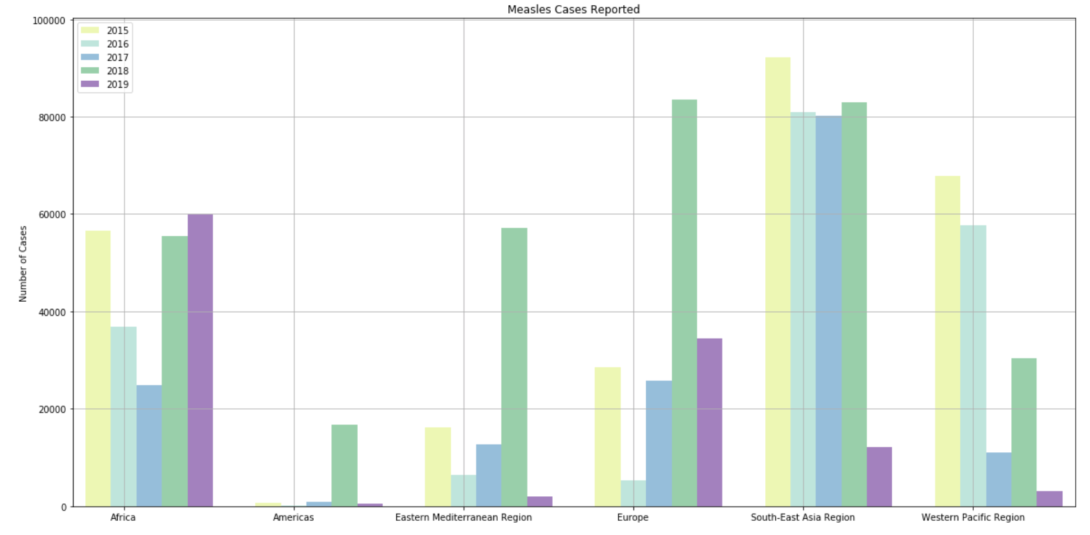
Question 1 : Over the last five years, were cases of measles outbreaks on the rise globally?

Slide 7
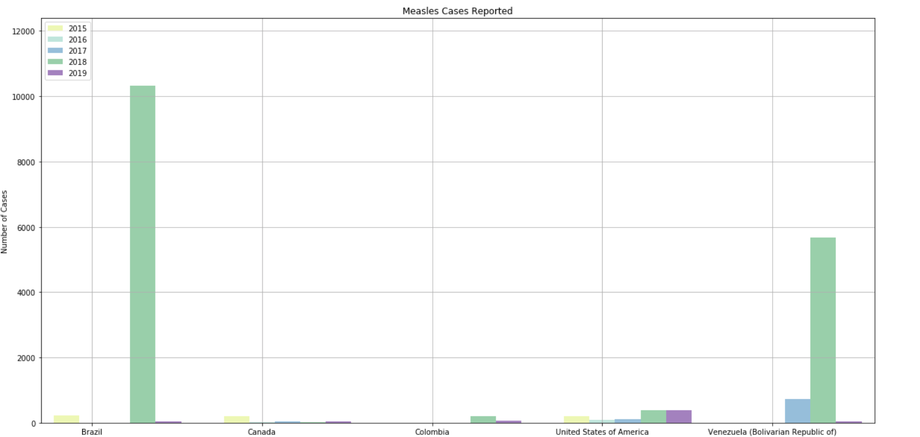
Measles Cases in the Americas

Slide 8
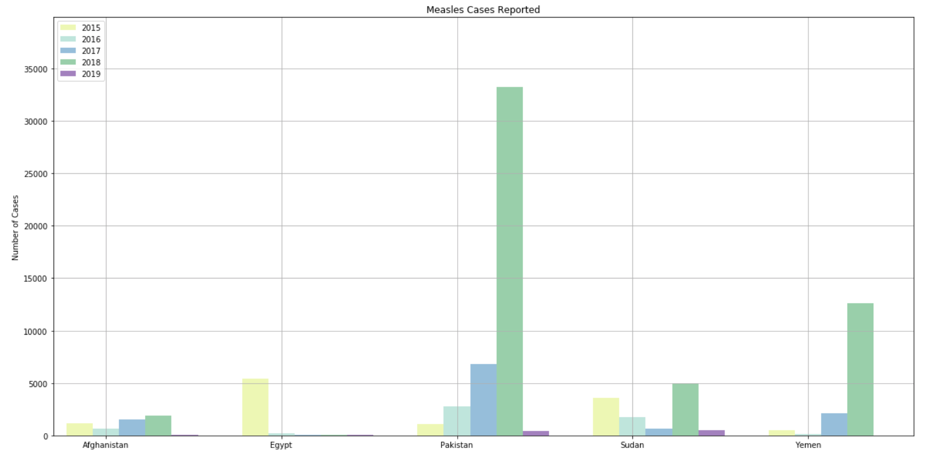
Measles Cases in EMR

Slide 9
Question 2: During the period in question, what was the distribution of measles outbreaks between the developed and developing world?

Slide 10
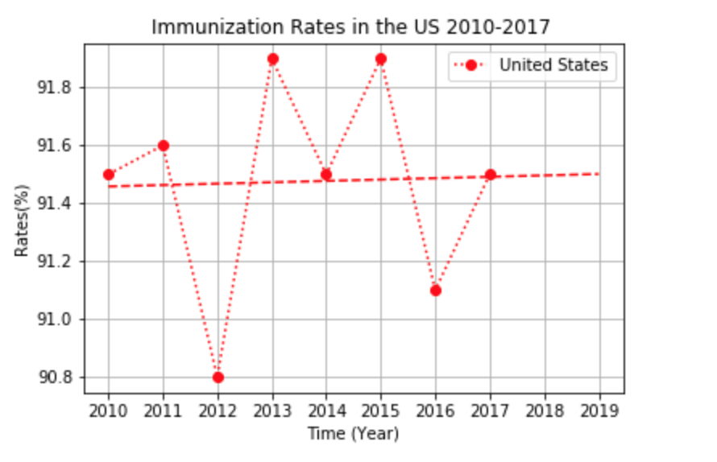
Question 3: Has there been an increase or decrease in MMR vaccinations in the U.S. over the last 10 years?

Slide 11
Question 4: How did the 2015 outbreak of measles in the U.S. influence MMR vaccination rates? As a result, what response could we expect to see during the current outbreak?

Slide 12
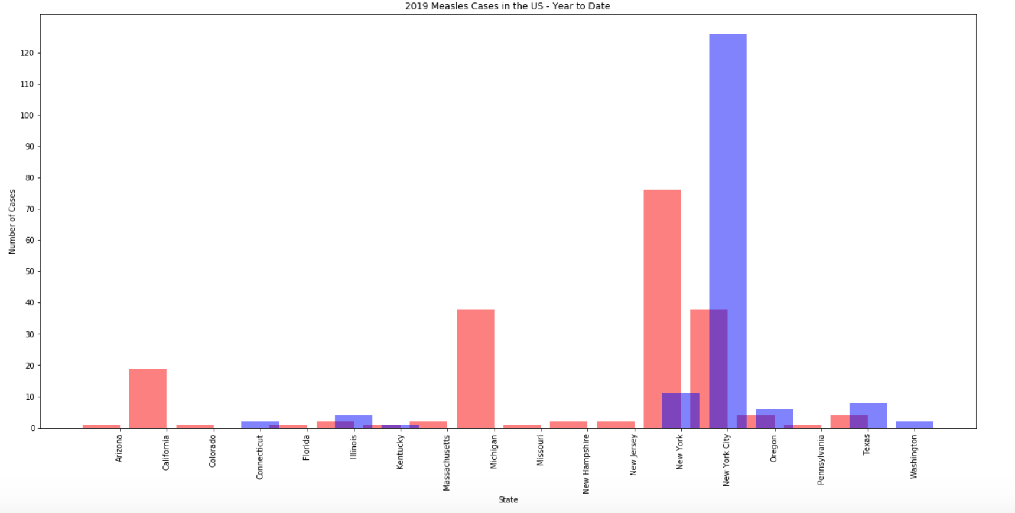
Question 5: What is the current distribution of indigenous and imported measles cases in the U.S.?

Slide 13
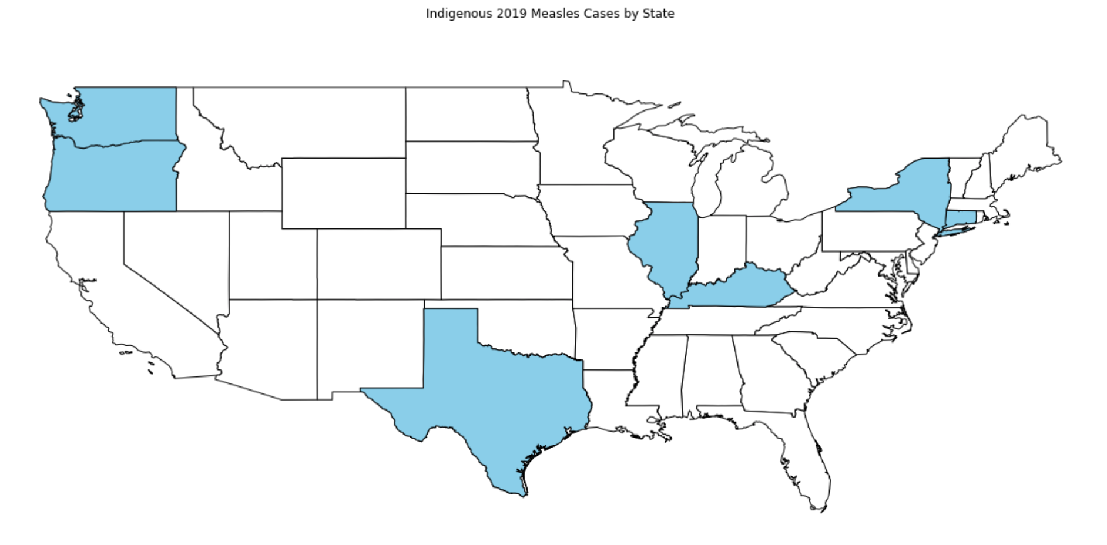
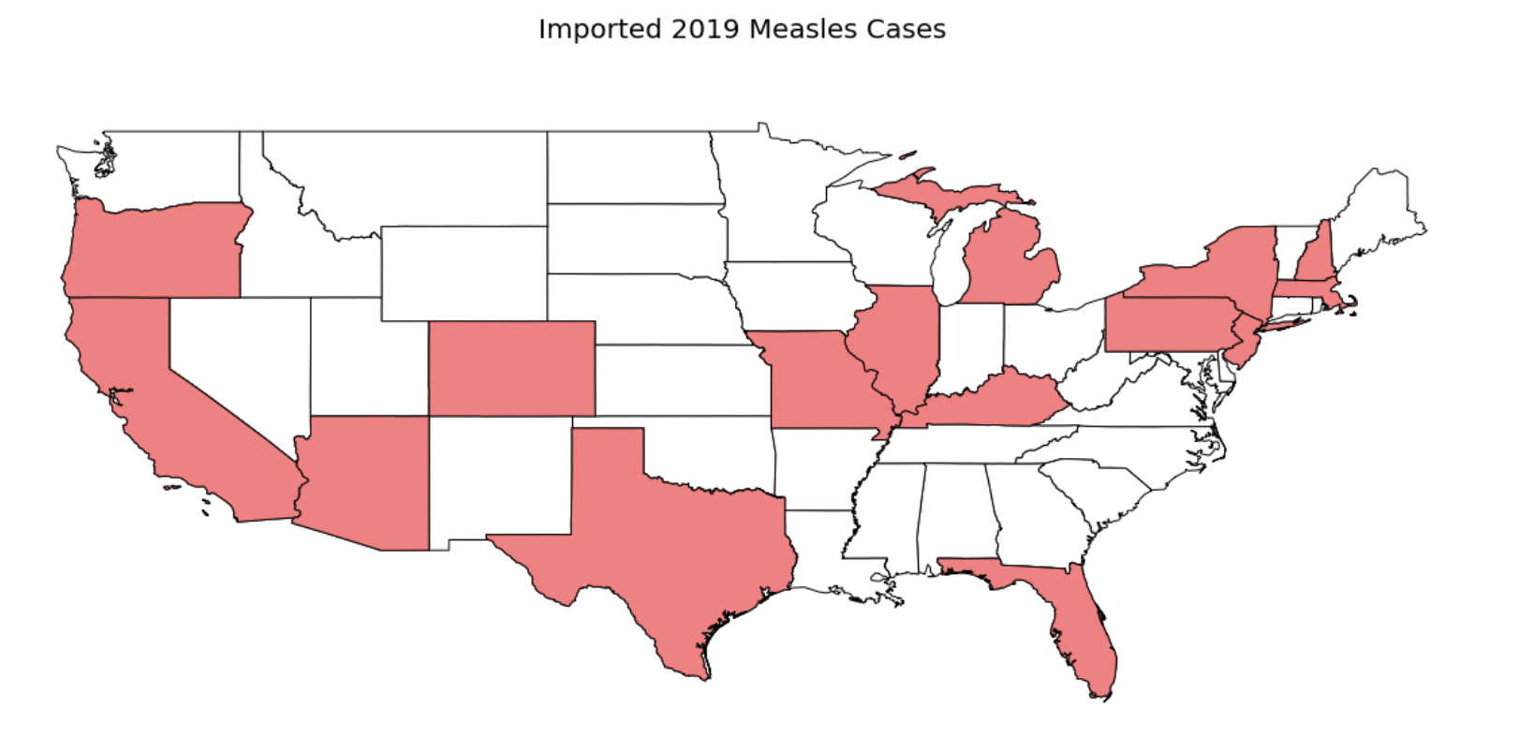

Slide 14
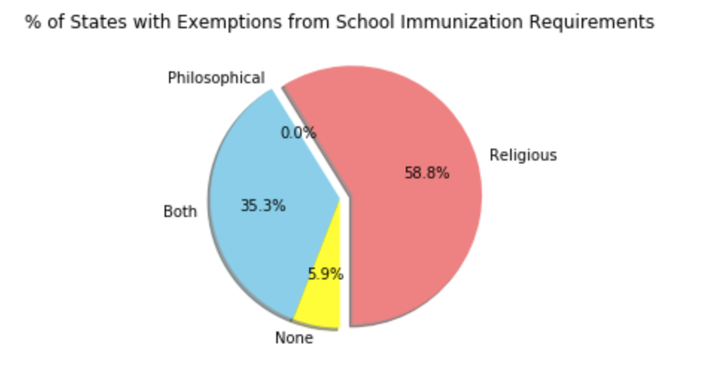
Question 6: What is the relationship between state vaccination exemptions and measles cases reported by state?

Slide 15
Post Mortem
Challenges:
Too little data
Too much data
Data discrepancies:
Time ranges
Sourcing conflicts
Unanswered Questions/Avenues for Additional Research:
Utilize Census data to investigate:
The percentage of the population that was insured in outbreak areas
The average level of education at outbreak sites
Notes:
Challenges:
Too little data
Too much data – what was relevant to our questions
Different time ranges
Different sources (conflicts)
Unanswered Questions/Avenues for Additional Research:
We wanted to show the relationship between the outbreaks in the US vs what states had exemptions. If we had more time, we would have looked into using a matplotlib basemap
Question 2
Question 3

Slide 16
Questions?

Slide 17
Backup Slides

Slide 18
Visualizations
1. Measles Outbreaks by Continent 2014-2019 - Cristy
2. Measles Outbreaks 2019 (Top 5 countries within each continent) - Cristy
3. Measles Outbreaks by Country Classification (income level) - Stefanie
4. Immunization Rates in the US 2010-2017 to Present (w/ trendline for '18, '19) - Ning
5.Immunization rate vs. outbreak in 2014/2015 (period of last measles outbreak in the US) could use this visualization to further explain trend analysis in #3. - Hemani
6. Measles Cases Reported in the US (by state) 2019 (indig vs imported) (bar graph) - Hemani
7. Relationship between state exemptions and measles cases reported by State in 2018/2019 - Olan

